Slide 1
Like Physics? Options for Mechanical Engineering Majors Prof. Zimmerman: zimmermant@uwstout.edu
Physics Major
Physics Minor
(~30 cr. beyond ME requirements)
Intro to Physics Research
Intro to Quantum Mechanics
Computational Classical Physics
Solid State Physics
Applied Optics and Photonics
Advanced Physics Lab
Quantum Mechanics
Applied Electromagnetics
Computer Science I and II
(5 cr. beyond ME requirements)
Statics and Dynamics or University Physics I
University Physics II
11 credits from the following:
PHYS-139 Intro to Research
CEE-355 Applied E&M
Any PHYS-3XX
Thermodynamics (PHYS-222 or ENGR-275 or ME-390)
for flowchart

Slide 2
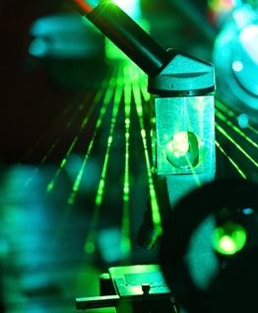
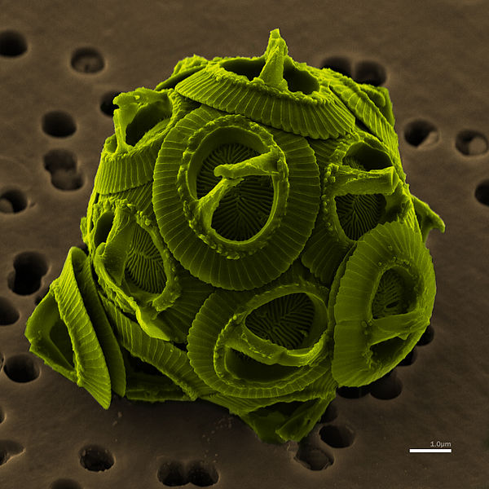
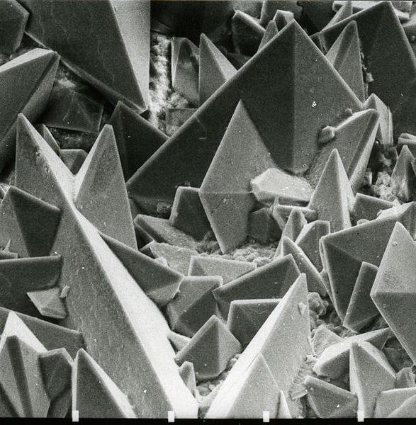
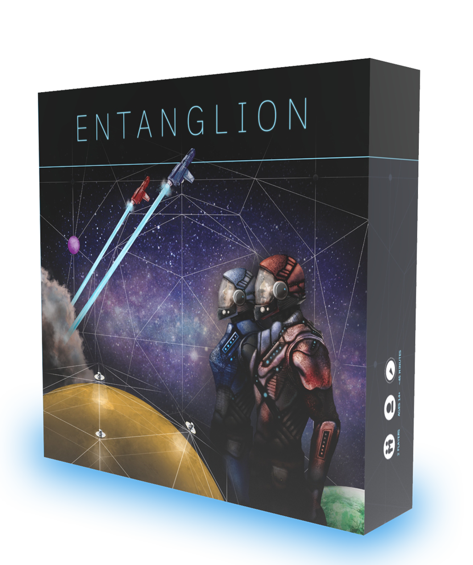

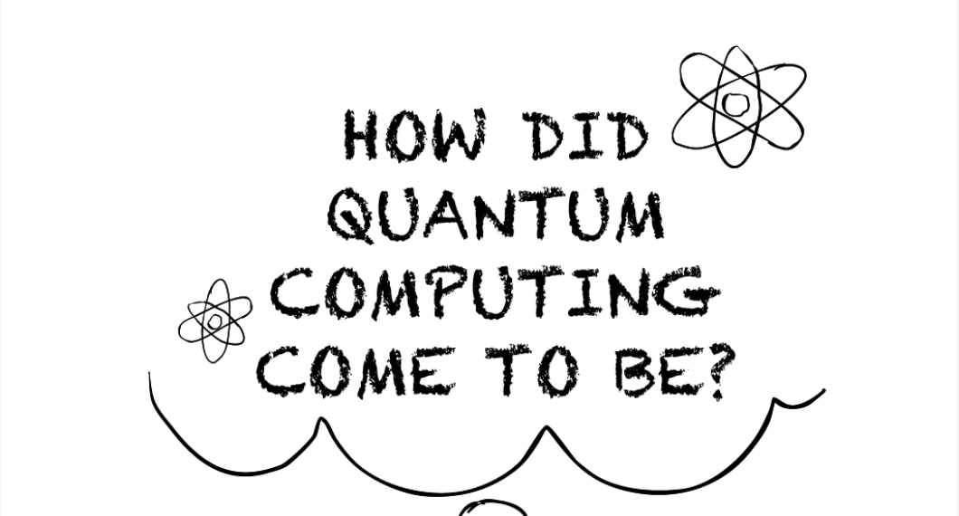
Fall 2025 Classes
PHYS-335 Applied Optics and Photonics
Counts as a Tech Elective for some engineering majors
NANO-230 MICROSCOPY
MW 11:15-12:10
Th 10:10-12:10
PHYS-113 Quantum Revolution for Everyone
Tu/Th 1:25-2:20 (class), F 12:20-2:20 (lab)
Gen Ed: ARNS with lab (3 cr), pre-req(s): none
Optical, electron, scanning probe microscopy; Dynamic light scattering, diffraction, emission spectroscopy. Learn techniques to observe nanoscale molecules and materials.
P: CHEM-135 or NANO-101

